Slide 1
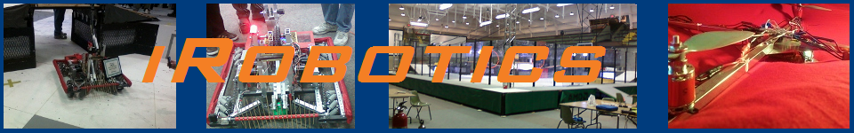
sbRIO Control System
Summer 2012
Release 1.0
Christopher Gerth – Development Lead

Slide 2
Overview
What?
A customized, highly flexible, and extremely powerful control system for JSDC robots.
Adaptable to any possible robot configuration
How?
Through a generous donation of hardware and software by National Instruments
Why?
To build groundwork for future members to have the engineering ability to execute any control system design

Slide 3
Block Diagram
Xbox controller
Xbox controller
Robot
Robot mechanical interfaces
Xbox receiver
sbRIO
USB link
Wifi Router
Other Ethernet-based Interfaces
Host PC
Wireless Ethernet Link

Slide 4
sbRIO
Basis of the System: National Instruments sbRIO 9642
400 MHz Processor, 256MB long-term storage, 128MB program-accessible DRAM
2M gate Xilinx Spartan FPGA
110 3.3v DIO lines, 32 16-bit analog inputs, 4 16-bit pure voltage (not pwm) analog outputs
32 High-current DIO’s (Run from external power supply at 6-30V)
10/100BASE-T Ethernet, RS232 port
Performs all major calculations and generates control signals for robot’s mechanical interfaces
Many interfaces available, but only some are broken out through custom hardware plugs. These can be remade in future years as designs require more interfacing.

Slide 5
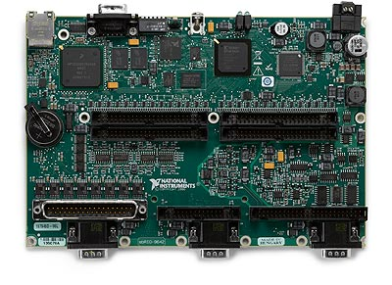
sbRIO

Slide 6
WIFI Router
Cisco Linksys E2500 Router/Wifi access point
Supports B/G/N 2.4 GHz and 5.0Ghz Wifi
Located on the Robot
Facilitates rapid communication between Host PC and Robot
Allows other IP-based peripherals (like cameras) to be interfaced.

Slide 7
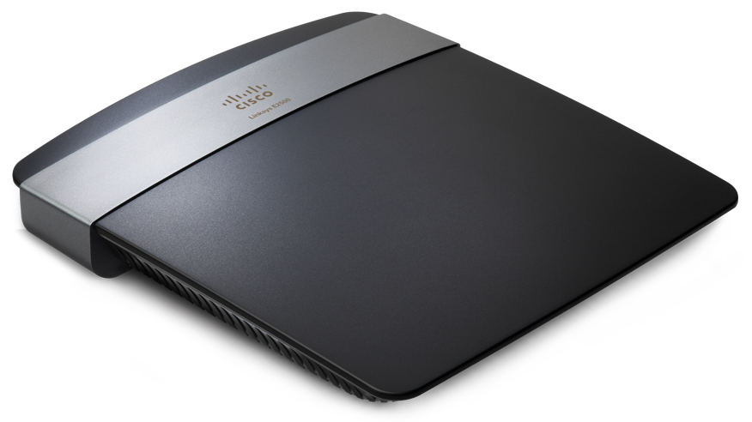
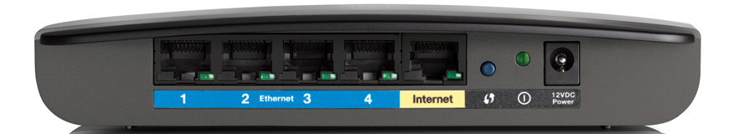
WIFI Router

Slide 8
Host PC
Primary development tool
Should be club laptop
Runs NI’s Labview development environment
Interprets USB-based operator interfaces
Maintains server for all robot-PC communication
Primary purpose is to have a library of shared variables which can be published over the main Ethernet Link
Secondarily, serves as a monitoring point to view all data streamed into and out of the robot, as well as current controller status.

Slide 9
Driver Interfaces
Xbox 360 controllers (2x)
Wireless, both communicate with PC through a special receiver (purchased with the controllers) and USB
Abstracted through a DirectX interface; Labview handles all communication interfacing.

Slide 10
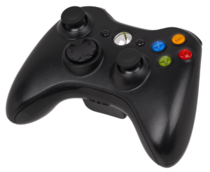
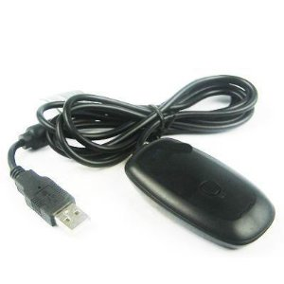
Driver Interfaces

Slide 11
Software
Developed under NI’s graphical Labview environment.
Three main VI’s, controlling the three processors
Host PC’s processor
sbRIO’s processor
sbRIO’s FPGA
Communication between these three asynchronous processes occurs via shared variables, or an FPGA FIFO.

Slide 12
Software SubFunctions
VI running on the Host PC serves only to establish shared variable server, and transfer joystick data to the sbRIO
VI running on sbRIO maps joystick values to motor values with appropriate scaling
Coordinates inputs from sensors with desired actions based on joystick/button input.
VI running on sbRIO’s FPGA handles all time intensive tasks, as well as routing all I/O data to the processor
Currently, it tracks encoder positions and generates PWM signals
Care needs to be taken when altering this design – recompiling the code takes over 10 minutes.

Slide 13
Communication Block Diagram
Upstream
Downstream
Host PC
sbRIO Processor
sbRIO FPGA
Mechanical Interfaces
FIFO and Network Published Data
FIFO Registers
PWM, TTL 3.3v Logic, Analog IO

Slide 14
Communication
Host PC <-> sbRIO Processor
Both run co-dependent VI’s
Utilize Shared Variables
Stored primarily on Host PC
Published to the Network
FIFO data structure used for deterministic data transfer of critical data downstream from PC to sbRIO
Host PC’s main loop runs slower than sbRIO’s so that FIFO does not clog up.
Status information associated with the interface of the VI is transferred back to the PC periodically.

Slide 15
Communication (IP)
Wireless Ethernet (WIFI) link is the primary control method
Static IP addresses
sbRIO:192.168.1.73
Router:192.168.1.72
Subnet mask: 255.255.255.0
Router Name (Not network name): Cisco73548
SSID: iRobotics (hidden)
Network key: *******************

Slide 16
Communication (IP Security)
WAP2 Security
AES Encryption
Other teams should not be able to sniff the packets
5 GHz radio disabled
SSID Not broadcasted
Wireless access restricted by MAC Address (only sbRIO and host PC allowed to connect)
Other teams should have a very hard time connecting in to our network
No Firewall enabled (so don’t hook the internet up!)

Slide 17
Communication
sbRIO’s Processor <-> FPGA
Again, FIFO data structure used in downstream direction.
FPGA runs much faster than processor
Processor loop time = 10 ms
FPGA loop time = 1.89 µs
Upstream data flow is read by processor from buffered registers.

Slide 18
FPGA
Fully Programmable Gate Array
Serves multiple functions
Routes all I/O into processor
Frees up processor from time-critical tasks
Generates PWM signals
Counts encoder ticks to keep track of wheel position

Slide 19
Safety Cutouts
Maintaining safe operating conditions in the event of a communication failure is of paramount importance
When VI is shut down, sbRIO passes high (invalid) signals to PWM outputs.
Should be accounted for when designing systems which receive digital outputs
When Ethernet is disconnected but VI continues to run, PWM signals go to 1.5% duty cycle (full stop)
Possibility of reconnection, so sbRIO waits for new signals.
Accomplished through a timeout monitor – if it takes more than 50ms to read in a shared variable, motors will shut down.
Digital outputs remain unaffected
Independent “Emergency Stop” variable exists for a software-initiated stop.
Watchdog timer resets controller in even of processor glitch or communication shutdown
Implemented for both CPU (in hardware) and FPGA (in HDL-software)

Slide 20
Outputs (1)
PWM
8 implemented in Hardware
Three pin outputs: Ground, +5v, Signal
Pulse lasts between 1 and 2 ms, and repeats every 20 ms.
Results in a 500 Hz square wave, with duty cycle between 1% and 2%
1.5% is full stop, 1% is full reverse, 2% is full forward.
Victors might have to be calibrated, IFI systems seem to use a slightly different system.
Digital
3.3v output, 3mA output per channel, 330mA total max.
Analog
4 pure analog (not PWM) outputs.
Range from -10v to 10v at 16 bit resolution, 3mA max drive.

Slide 21
Outputs (2)
Relay (Spike)
Same as Digital outputs, but grouped into two pins on the red and white wires in a PWM cable to drive a Spike Relay.
High-Current
10 implemented in hardware.
Sourcing output from an external power source at 6v to 30v
250mA output per channel, possible to increase to 1.5 A with heatsinks
Total Power not to excede 20A or supply’s maximum

Slide 22
Inputs
Quadrature Encoder
Each one consists of two inputs, one for each channel
Counts normal two-bit grey code output, stores current position in FPGA register for use by the processor
Utilizes XOR algorithm which accounts for small-angle rotations, and increments by four every full grey code cycle.
Digital
3.3v input, 5v tolerant (compatible with TTL)
Analog
Unimplemented in hardware, but 32 single ended or 16 differential inputs exist
16 bit resolution on a -10v to 10v range
Run at 250kSamples/sec (max frequency = 700kHz)

Slide 23
Electrical Specs
sbRIO takes a 19-30v supply. We utilize the 24v boost power supply on the FRC power distribution board.
Take care to ensure digital ground remains isolated from battery/power supply ground.
Router takes 12 v. supply. Utilize the regulated supply on the FRC power distro board.
Fan for sbRIO also runs on 12v. It is electrically isolated from the main board.

Slide 24
Software Design Philosophy
Three Main VI’s:
Host Computer
Processor
FPGA
Main communication occurs between Host Computer and Processor
Utilizes NI’s Shared Variable system to manage multiple writers and readers from the same variables at the same time

Slide 25
Example VI’s
Most of the VI’s are here, just to give a taste of what is involved
Most also are specific to this year’s (2012/2013) control system
Holonomic drive (full continuous rotation of wheel assemblies)
Currently unknown parameters for other outputs, two extra motor ports and four spike ports currently available.

Slide 26
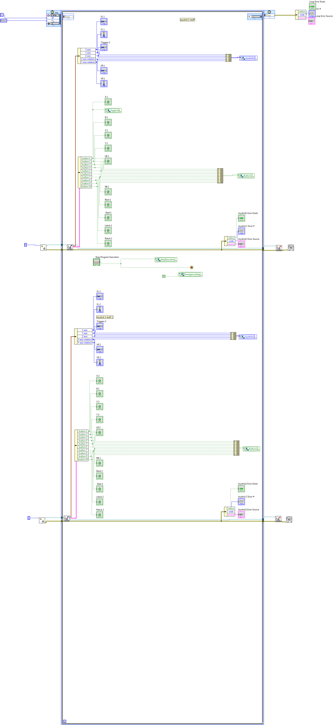

Slide 27
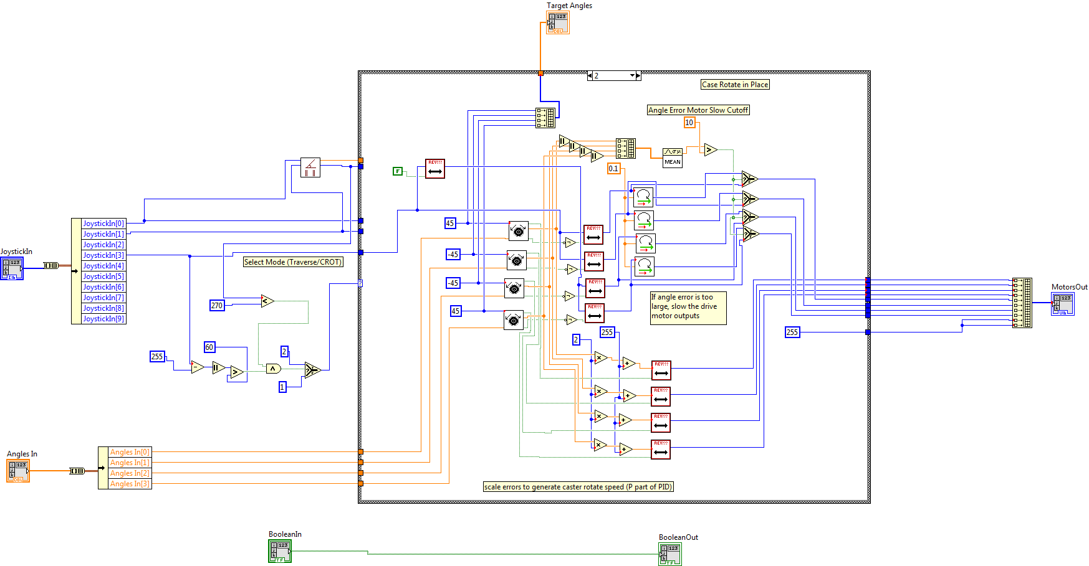

Slide 28
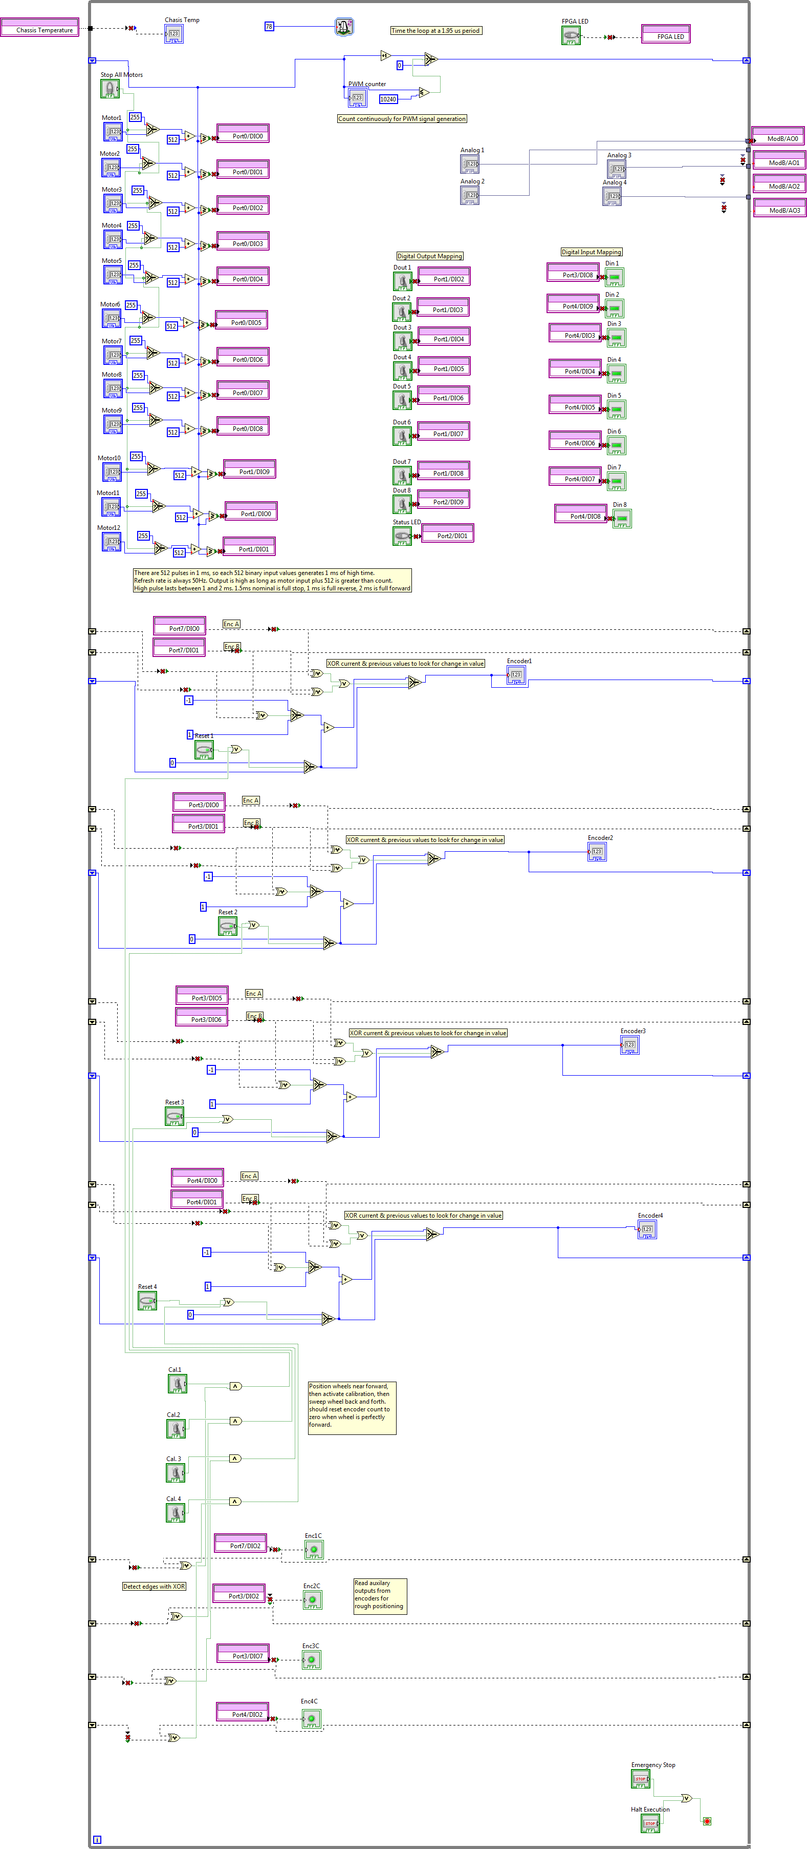

Slide 30
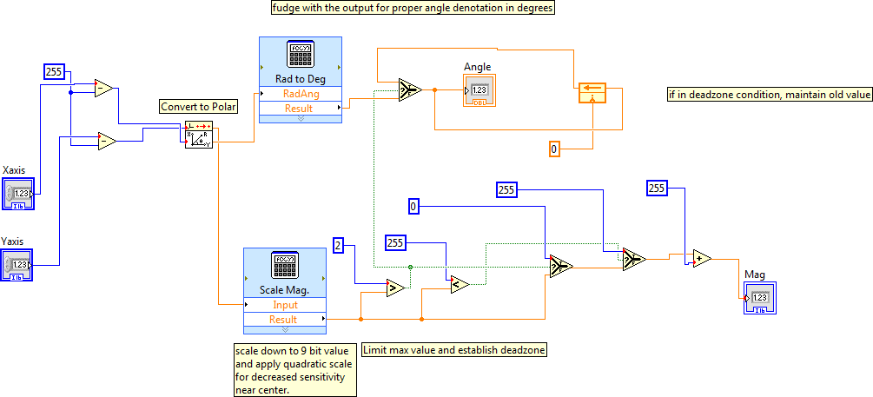

Slide 31
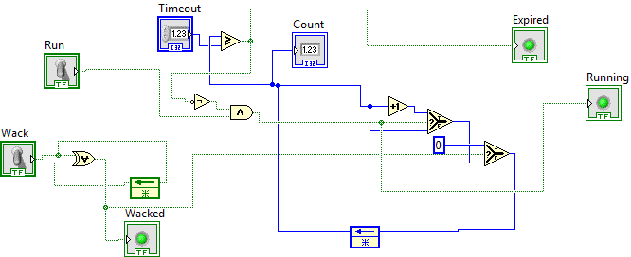

Slide 32
Shared Variables
Independent server runs on Host Computer
It is a time and resource intensive process, so the sbRIO should not be responsible for it.
Any VI running anywhere on the network can read or write to these variables
For simplicity’s sake, try to only have one writer, otherwise it is difficult to debug

Slide 33
Control Algorithm
A continual work in progress
Need to account for translational, rotational and arcing motions
Currently, case statement analyzes input and uses different algorithms for each type of motion.
Developing filters to smooth the transitions between each algorithm.
Derivative-controlled to ensure timely response and smooth operation
Goal – a control scheme based in a single, continuous equation for maximum speed and accuracy.

Slide 34
Software Simulation
“Debug Mode” part of sbRIO processor VI
Implemented for 2012/2013 year to simulate robot mechanical hardware
Keeps track of wheel positions and provides feedback info to control algorithm so there is a measurable error to correct for.
Allows for different correction rates, which simulates different physical robotics capabilities.

Slide 35
Revision Updates
1.0 – Base Release

